Slide 1
Topic: Digital Dice Circuit
Presented by:
Muhammad Hamza Farooq(200901019)
Muhammad Tayyab(200901018)
Hamza Humayune(200901085)

Slide 2
Objective: Basically digital dice circuit is a type of modern dice. People play games like ludo using dice and they can also cheat while playing with dice but playing with digital dice no one can cheat as while playing with digital dice, people can press button and when release that button, digital dice will generate random number from 1 to 6.

Slide 3
Components:
555 Timer IC
4017-IC
7SEG-MPX1-CA
74LS47 IC
1N4148 DIODE
LED BLUE
BUTTON
RESISTOR
CAPACITOR

Slide 4
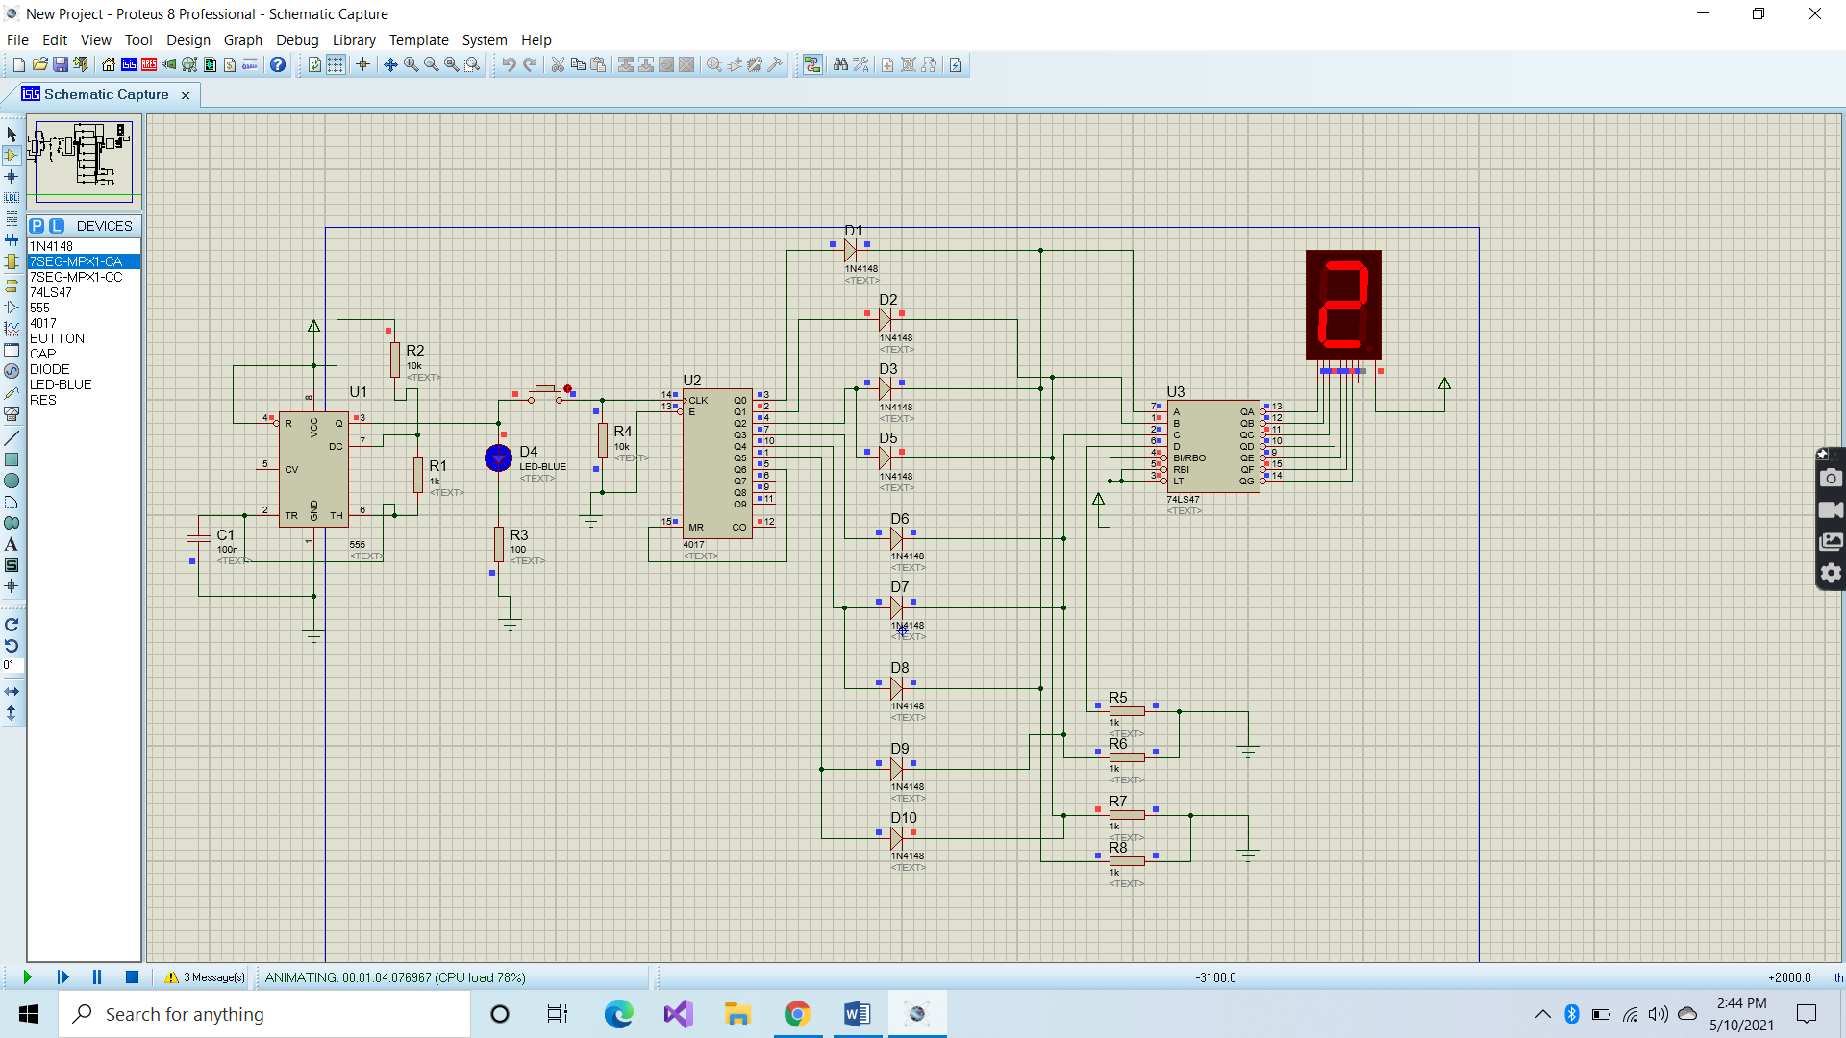
PROTEUS Diagram:

Slide 5
Explanation of Circuit:
In Digital Dice Circuit, first we will use 555 Timer IC to generate clock pulses.555 Timer ICs pin number 3 is its output which is attached to button and this button is also attached with the CLK pin(PIN 14) of 4017 IC. When we press the button, clock pulses generate from 555 timer ICs output to 4017 ICs input. Likewise when the CLK pin(PIN 14) is getting HIGH and LOW, output is shifted towards the output pins of 4017 IC. Output pins are from Q0 to Q9. But we need from only 6 outputs so we will attach output 7 pin(pin Q7) to reset pin(MR pin#15). We used 1N4148 Diode on the 6 outputs of 4017 IC so that reverse biasing will not occur. We used BCD to 7 segment pins 3 times that is why we used diodes in center.
If output 1(Q0) is HIGH, “1” will be displayed on 7 segment display.
If output 2(Q1)is HIGH “2” will be displayed on 7 segment display.
If output 3(Q2) is HIGH ,A and B input of 7 segment will become high and “3” will be displayed on 7 segment display.
If output 4(Q3) is HIGH ,C input of 7 segment will become high and “4” will be displayed on 7 segment display.
If output 5(Q4) is HIGH ,A and C input of 7 segment will become high and “5” will be displayed on 7 segment display.
If output 6(Q5) is HIGH ,B and C input of 7 segment will become high and “6” will be displayed on 7 segment display.

Slide 6
Applications or Games in which Digital Dice can be used:
SNAKE LADDER GAME
LUDO GAME
LUCK GAME (A type of game in which some prizes are enlisted on following numbers and when you get those number on your dice, you will get that prize.)

Slide 7
THANK YOU!

